Slide 1
SC1015 Mini Project
Done by :
Chan Kin Leong
Ang Jia Ze
Lin Dawei

Slide 2
Outline
01
Introduction
Problem Definition
04
Machine Learning
Naive Bayes
Random forest
K Neighbours
02
Data Extraction
Data Source Data Preparation
Outcome
05
Data driven insights
03
Exploratory Analysis
Skewed Data Classification Cleaning

Slide 3
INTRODUCTION

Slide 4


Slide 5
Problem Definition
Can we predict the outcome of the match based on 10 minutes worth of data and how can we improve the win rate of a match?

Slide 6
DATA EXTRACTION

Slide 7

Data Source

Slide 8
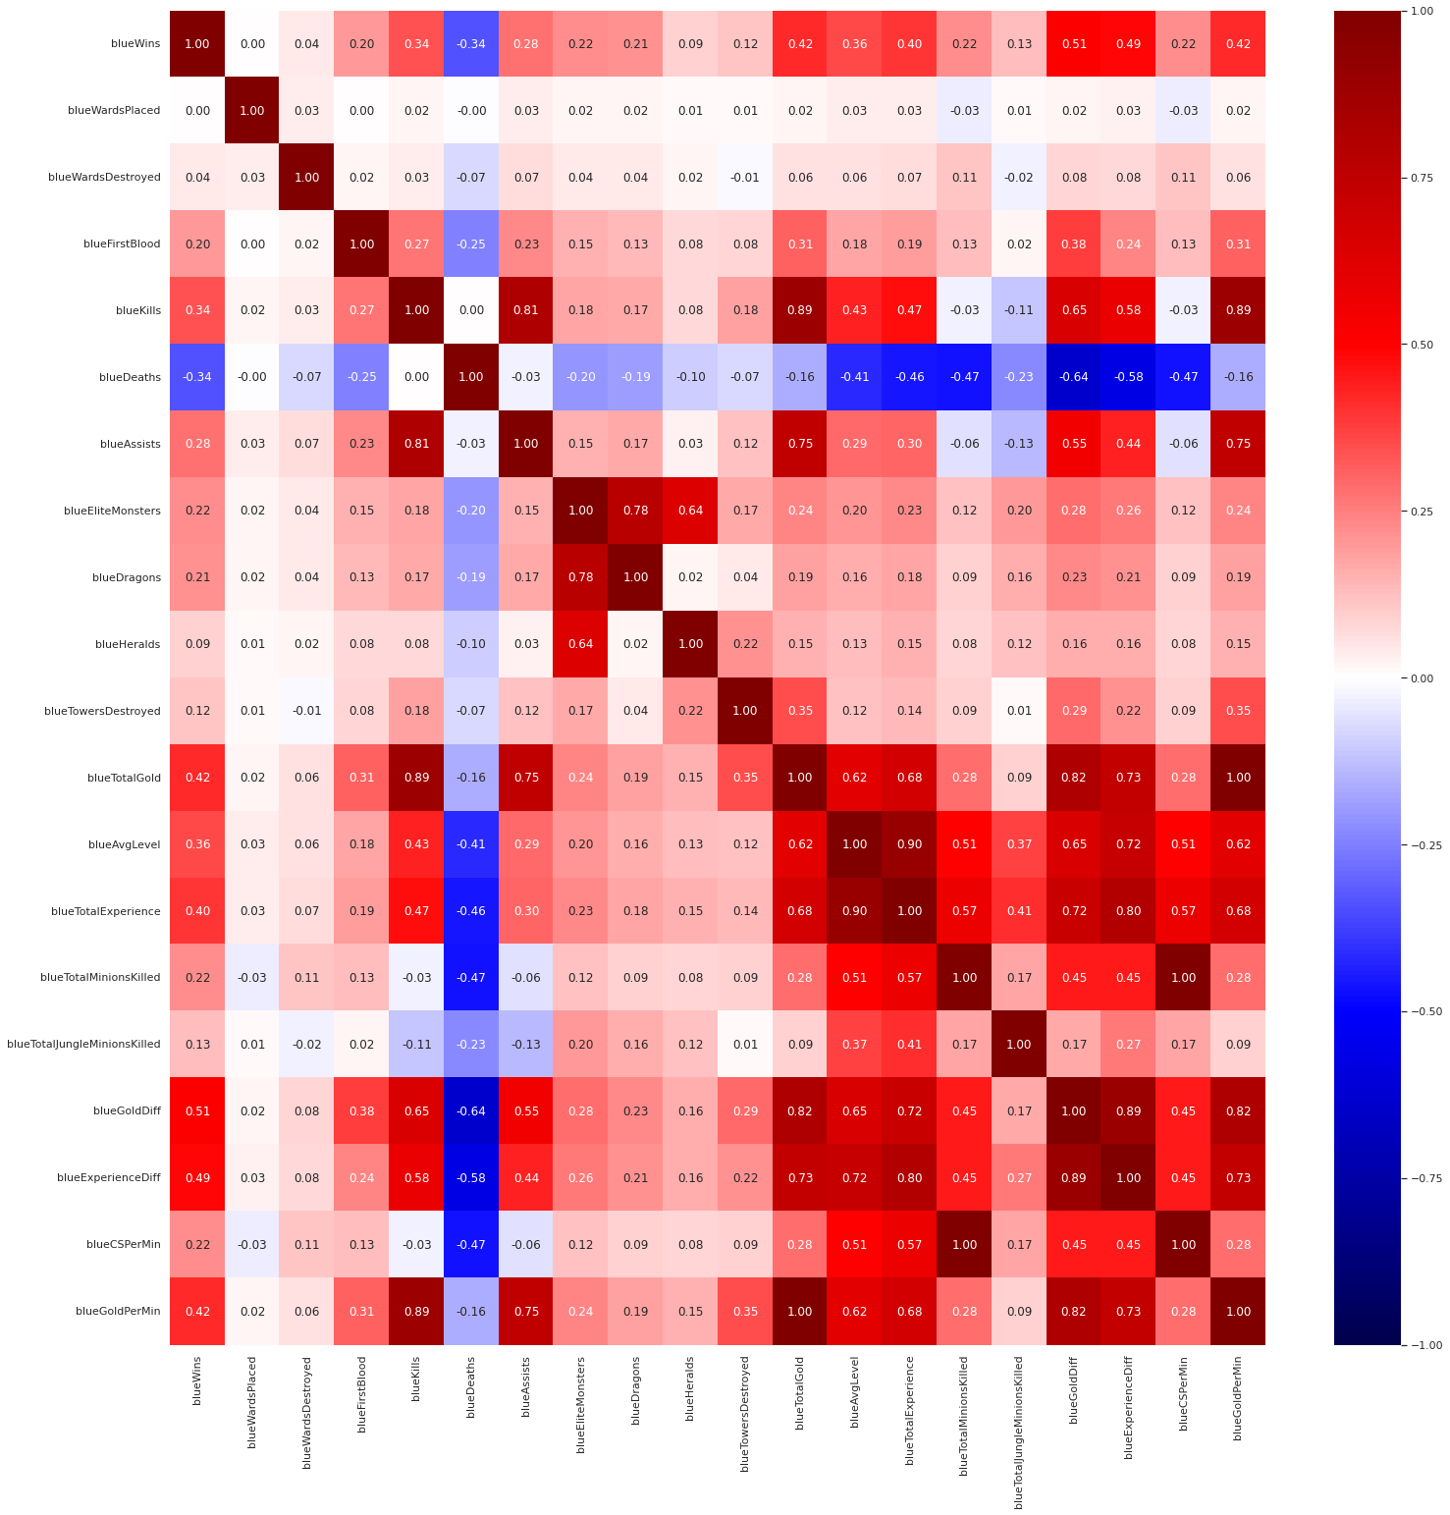
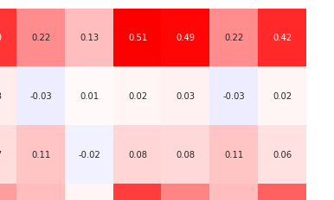
Correlation Matrix
gold
experience

Slide 9
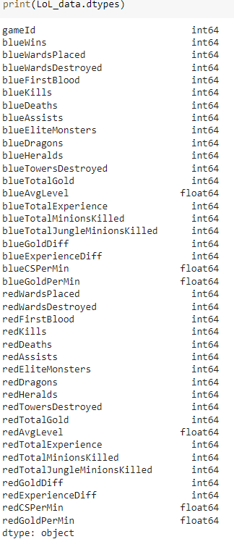
Data Preparation
Null entries
Checked for null entries
Extraction
Extracted data related to the blue team
Data removal
Money and experience
Data duplicates
blueEliteMonsters blueCSPerMin

Slide 10
EXPLORATORY ANALYSIS

Slide 11
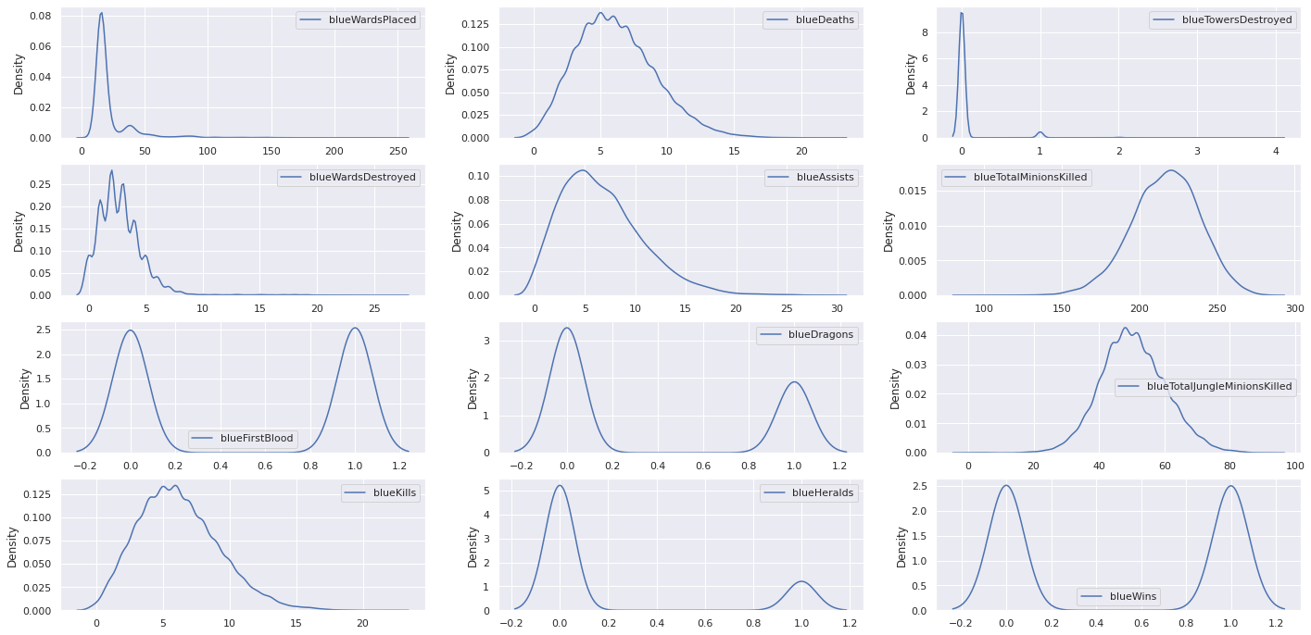
Skewed Data

Slide 12
Data Classification and Cleaning
Numerical
Categorical
Data Cleaning
blueWardsPlaced
blueDeaths
blueWardsDestroyed
blueAssists
blueTotalMinions Killed
blueTotalJungle MinionsKilled
blueKills
blueTowersDestroyed
blueDragons
blueHeralds
blueFirstBlood
Interquartile Range Method

Slide 13
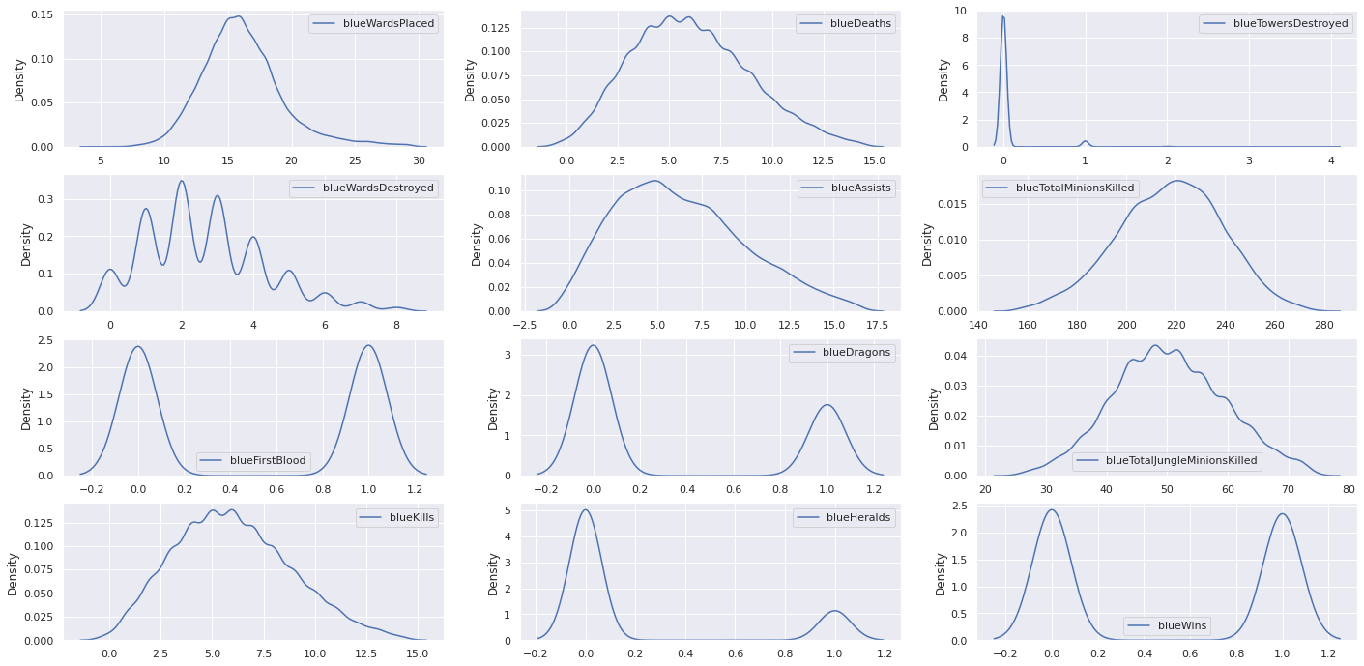
After Cleaning Data

Slide 14
MACHINE LEARNING

Slide 15
Machine Learning Models
01
Naive Bayes
Supervised Learning
02
K Neighbours
03
Random Forest

Slide 16
Training and Splitting Data
We set up a Multi-Variate Classification problem
Response Variable: blueWins
Predictor Features:
blueWardsPlaced
blueWardsDestroyed
blueFirstBlood
blueKills
blueDeaths
blueAssists
blueDragons
blueHeralds
blueTowersDestroyed
blueTotalMinionsKilled
blueTotalJungleMinionsKilled

Slide 17
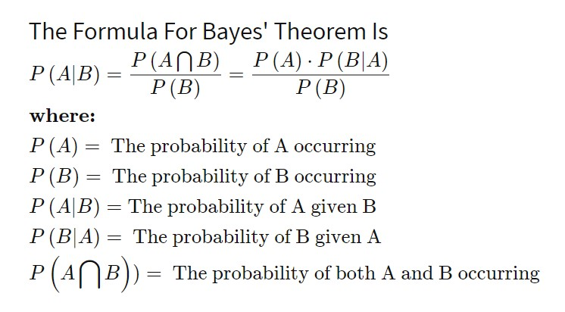
Machine Learning : Gaussian Naive Bayes
Naive Bayes
Bayes Theorem
Purpose
Purpose
Classification algorithms based on the Bayes theorem
High functionality
Used when dimensionality of the inputs is high
Used to calculate conditional probability

Slide 18
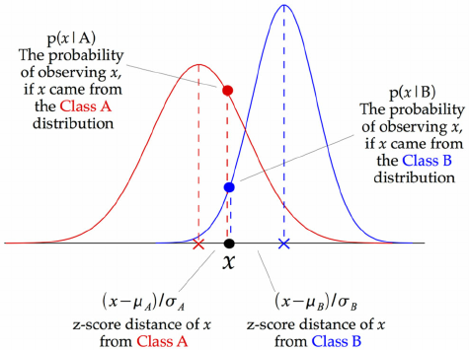
Machine Learning : Gaussian Naive Bayes
01 | Assumption
 | Data is described by a Gaussian distribution with no co-variance (independent dimensions) between dimensions
02 | How to achieve
 | Finding the mean and standard deviation of the points within each label
03 | Steps
 | At every data point, the z-score distance between that point and each class-mean is calculated, namely the distance from the class mean divided by the standard deviation of that class

Slide 19
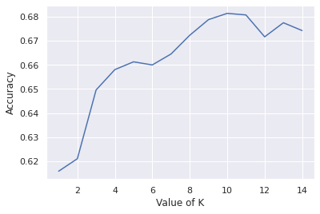
Machine Learning : K Nearest Neighbours
K Nearest Neighbours
Pros & Cons
Purpose
Pros
Plots training data on a graph and based the distance set (value of k) decide the outcome from the test data , choose value with the highest value of k (k=10 in our case)
Simple algorithm – to interpret
No need to make additional assumptions
Large numbers of variables in our data, predicted data point may be equidistant to many of the training data, giving inaccurate result
Cons
Notes:
change

Slide 20

Machine Learning : Random Forest
Random Forest
Pros & Cons
Purpose
Pros
Many random decision trees are generated each with random, different predictors
Decision is made by passing data to be predicted through all the trees and the majority chosen outcome will be picked
Reduces overtraining from training data, making the model more robust compared to stand alone decision tree
Hard to identify the process that led to specific outcome as large numbers of trees are used to calculate it
Cons
Notes:
https://cdn.analyticsvidhya.com/wp-content/uploads/2020/02/rfc_vs_dt1.png

Slide 21
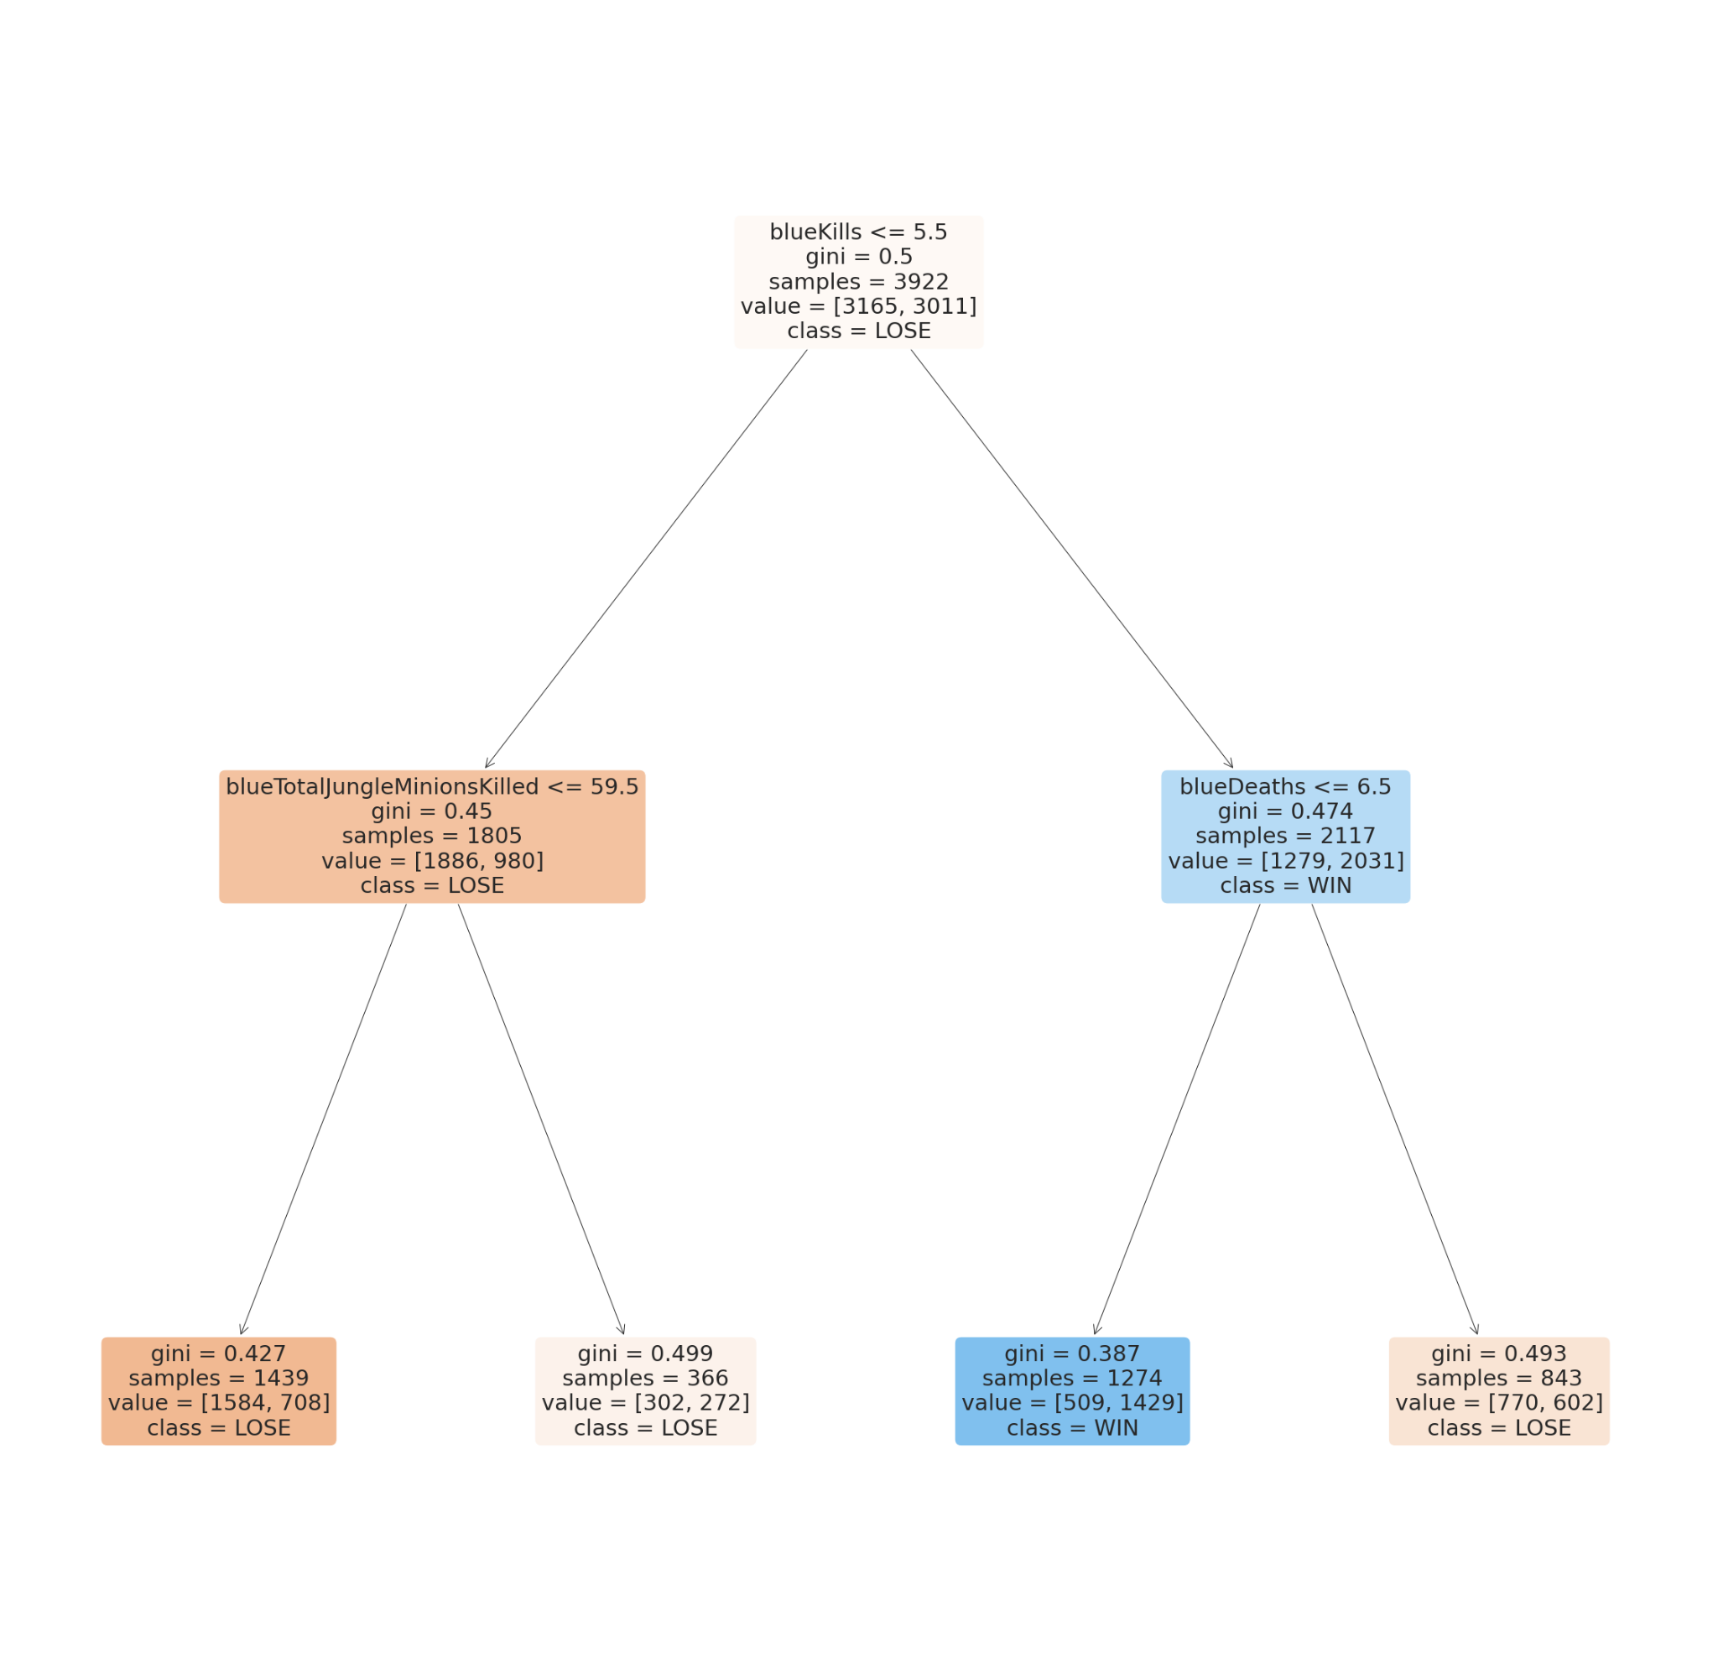
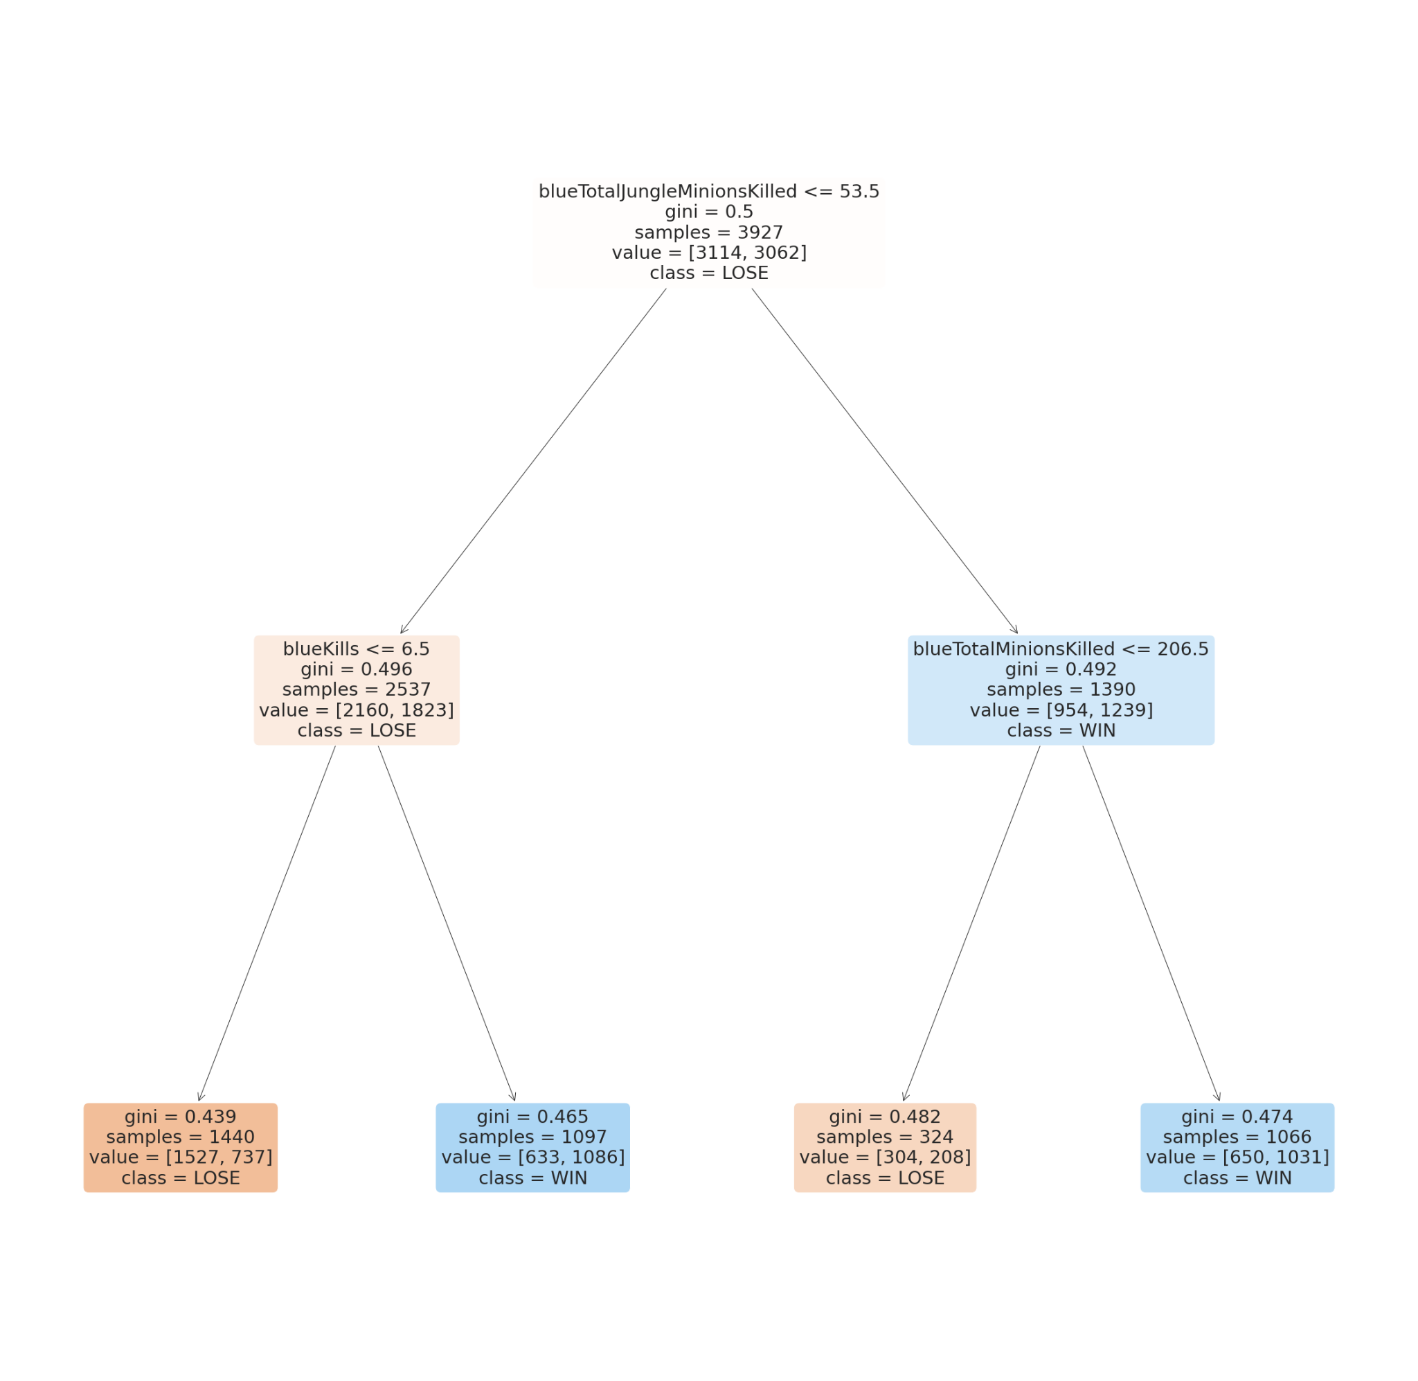
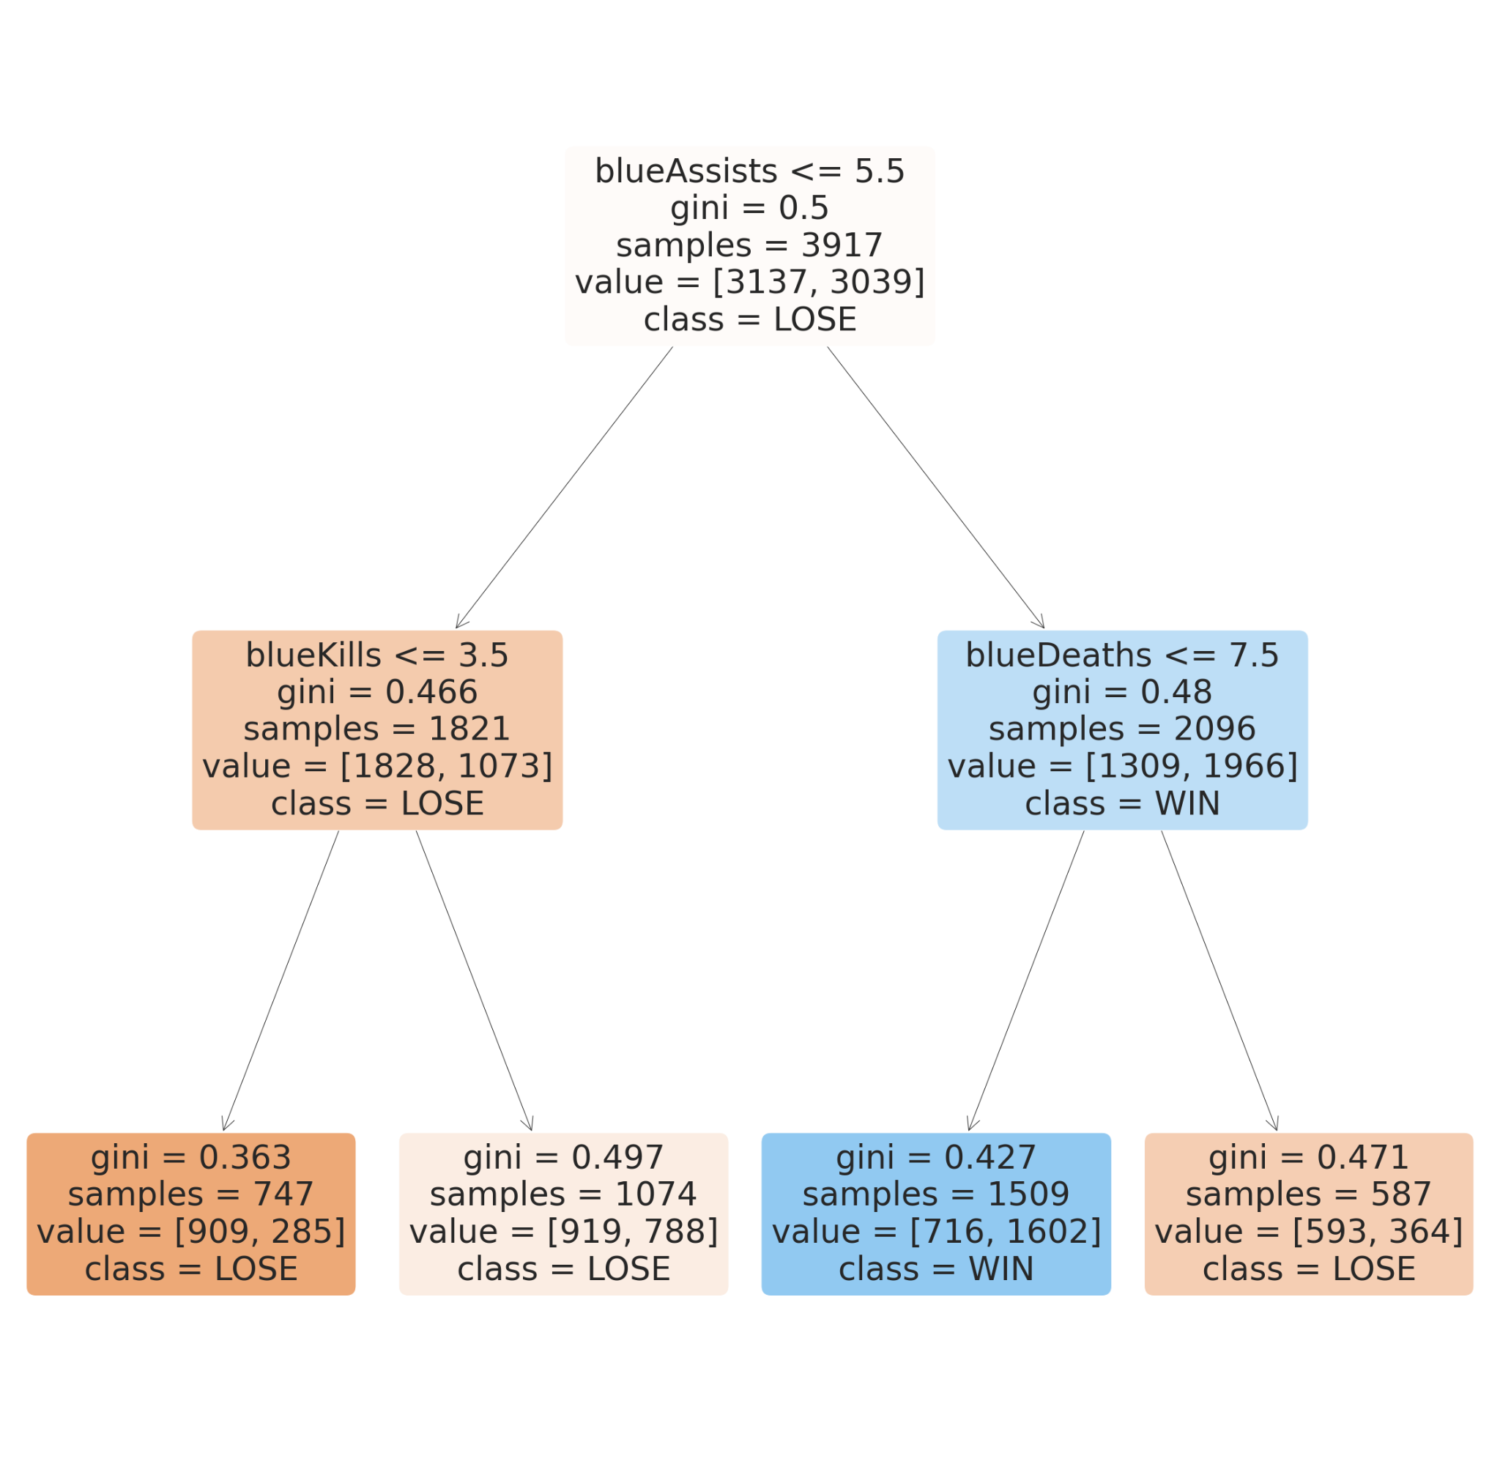
Machine Learning : Random Forest (Random Trees)

Slide 22
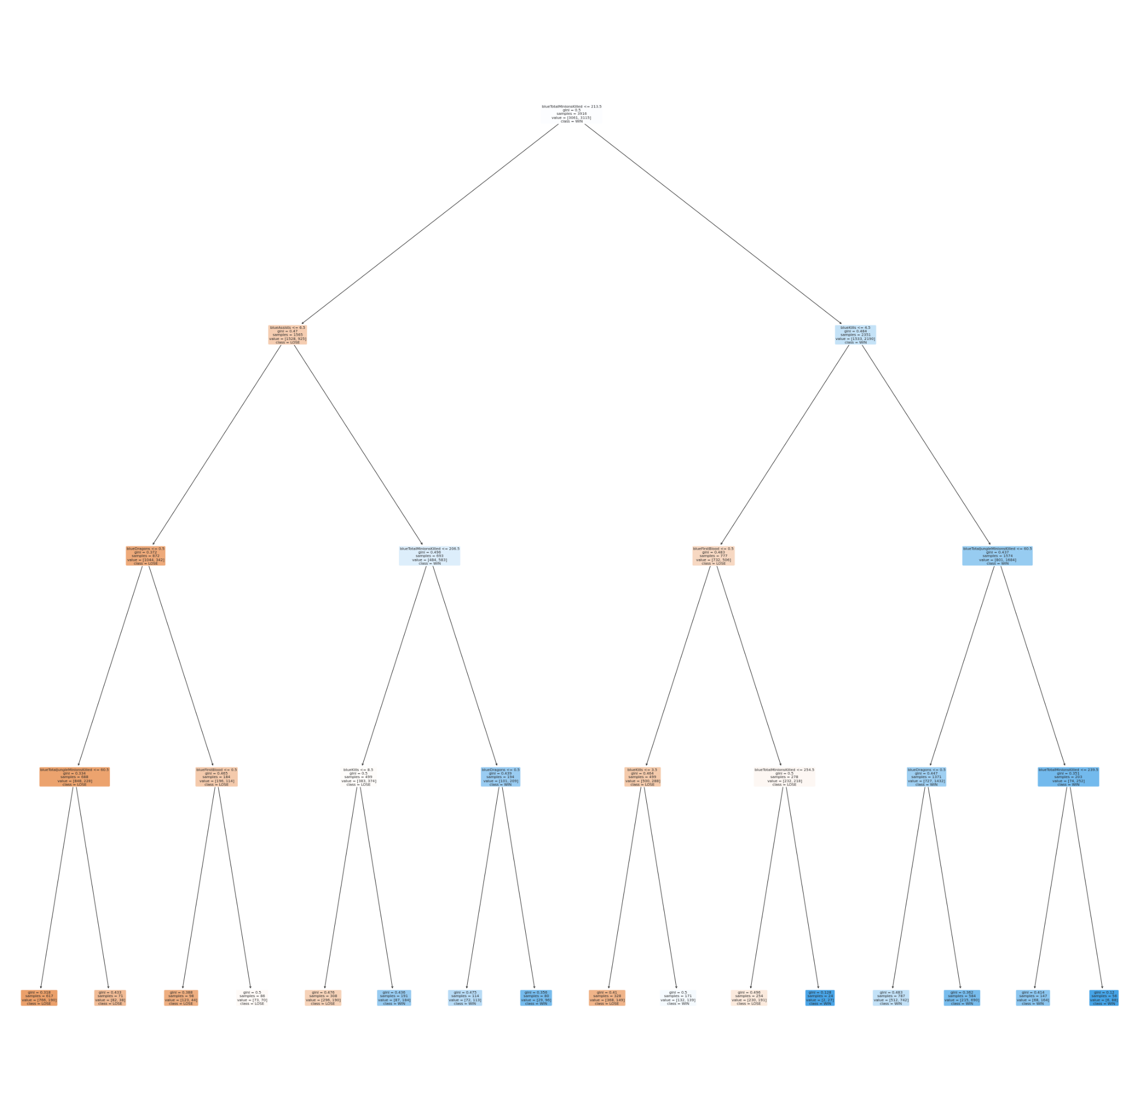
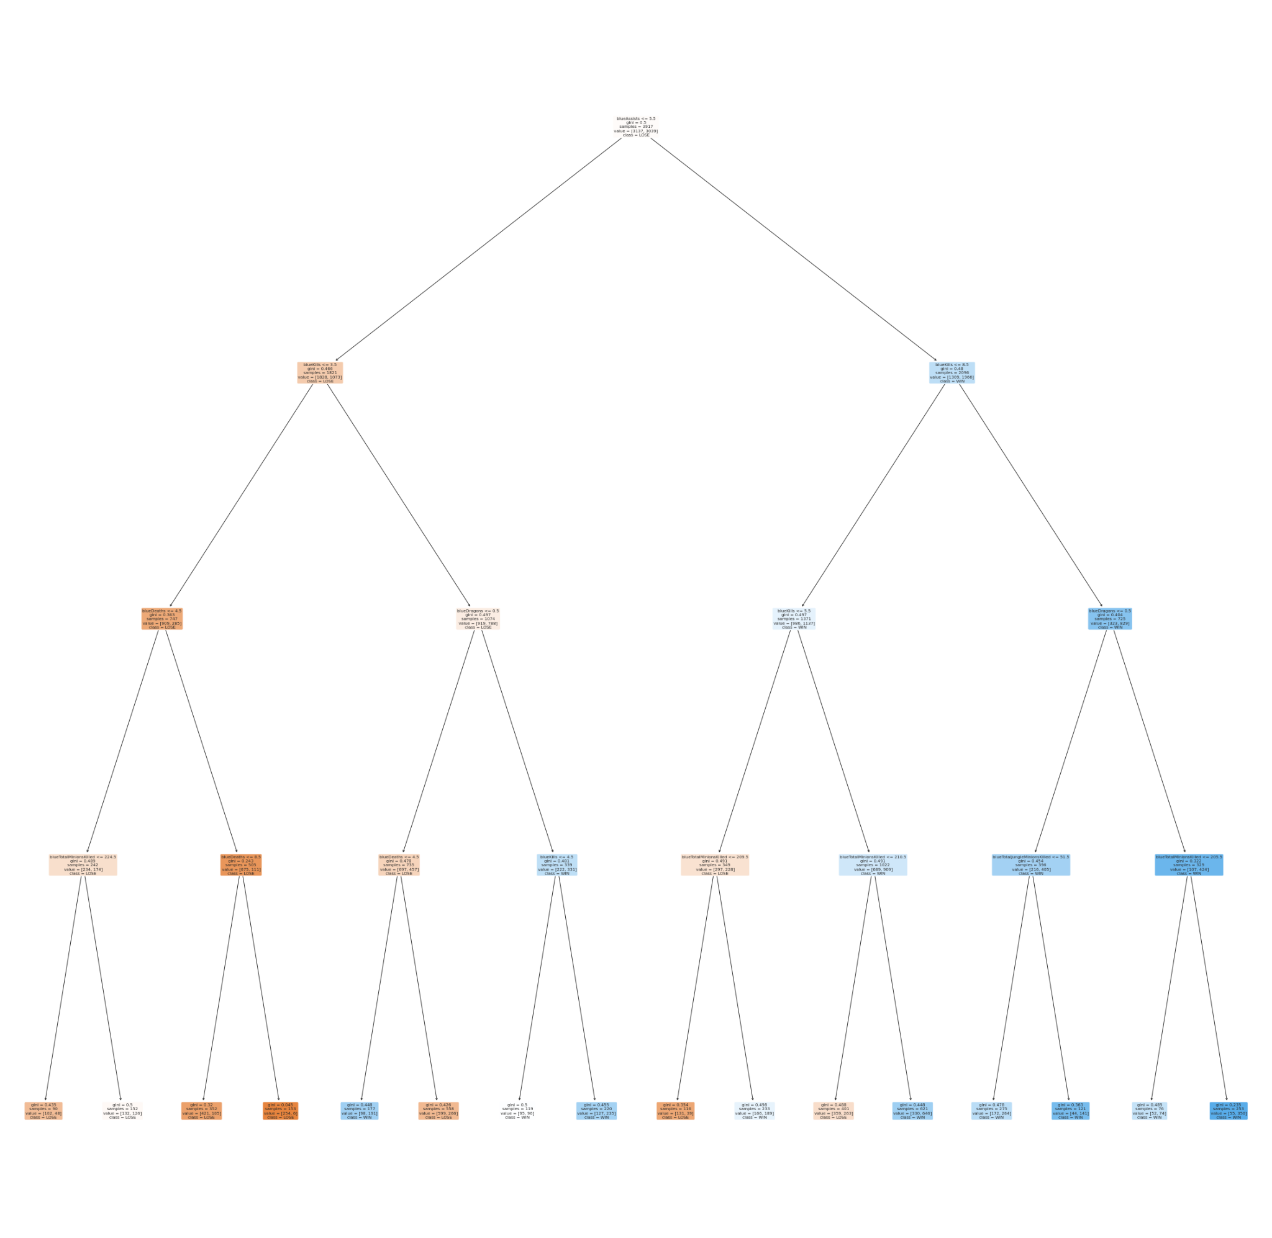
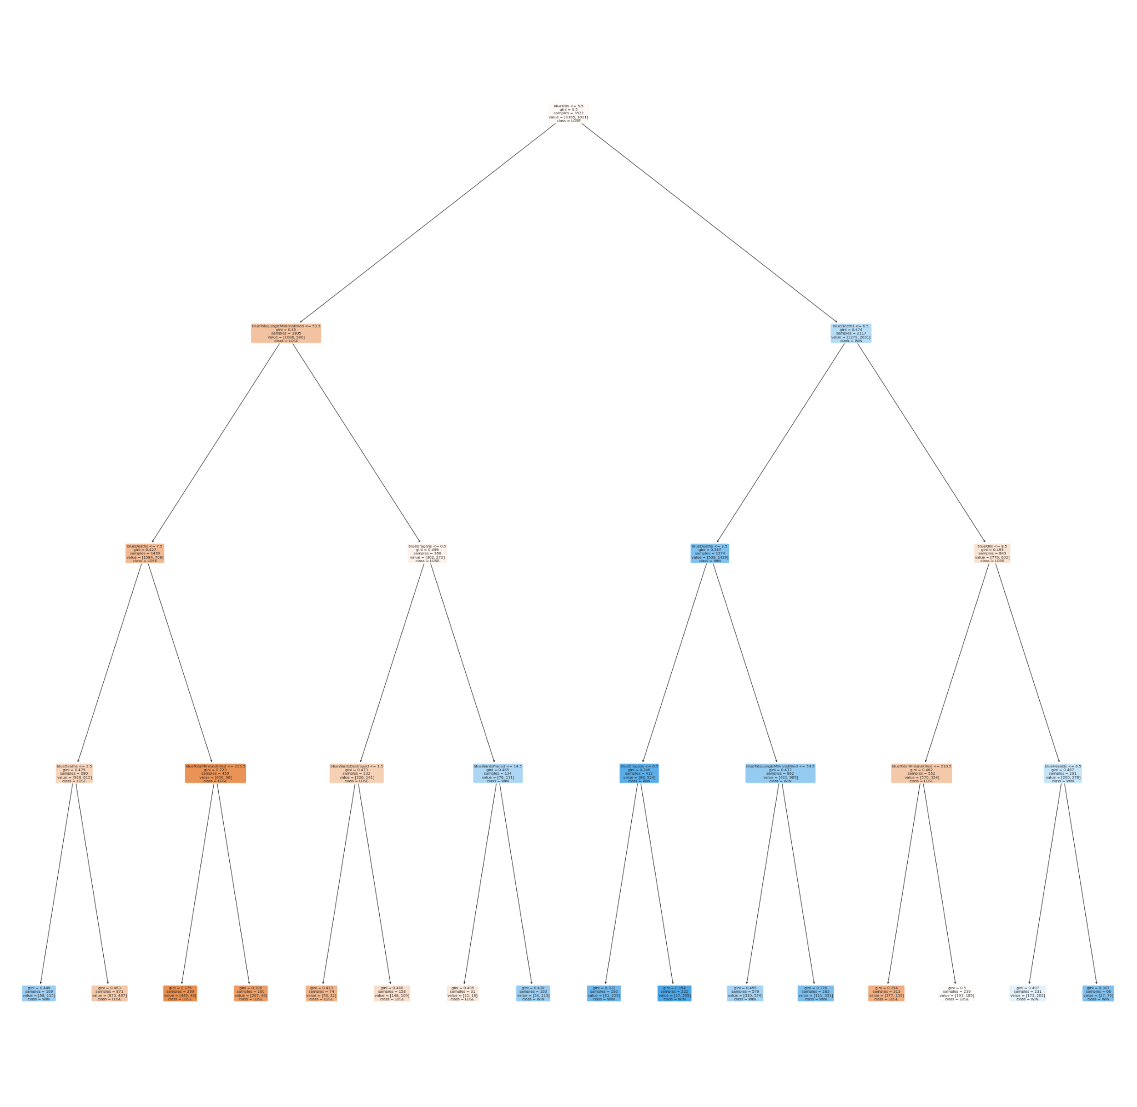
Machine Learning : Random Forest (Actual Depth 4)

Slide 23
OUTCOME

Slide 24
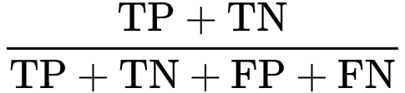
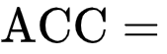
Comparison Between Models

Slide 25
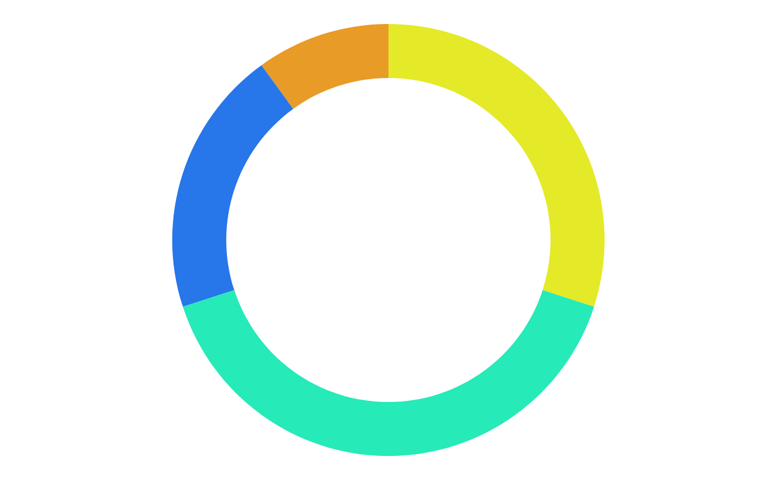
Overview Of The Machine Learning Models
Naive Bayes
K Nearest Neighbour
Accuracy: 68.1%
Recall: 79.3%
Precision: 65.8%
F-Score: 71.9%
Accuracy: 67.4%
Recall: 74.2%
Precision: 66.4%
F-Score: 70.1%
Random Forest
Decision Tree
Accuracy: 71.6%
Recall: 71.9%
Precision: 72.6%
F-Score: 72.2%
Accuracy: 71.6%
Recall: 69.4%
Precision: 72.4%
F-Score: 70.9%
Notes:
Bayes | 0.68135 | 0.79345 | 0.65762 | 0.71918 |
| R Forest | 0.71567 | 0.71914 | 0.72554 | 0.72233 |
| KNN | 0.67422 | 0.74181 | 0.66404 | 0.70077 |
| DecTree | 0.70661 | 0.69395 | 0.72405 | 0.70868 |

Slide 26
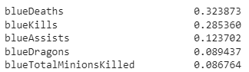
Outcome and Data-driven Insights
Outcome
Insights
Can we predict the outcome of the match based on 10 minutes worth of data?
How can we improve the win-rate of a match?
Variance Importance
Yes. As shown, the most accurate model would be the Random Forest classifier
Notes:
Should there be a fight we should try to win and assist our teammates but not at the expense of our life. So try not to do 1 for 1 exchange. If there are no fights, we should prioritize killing the dragon rather than heralds. While the dragon is being summoned. We should focus on killing the minions.

Slide 27
THANK YOU

Slide 28
References
League of Legends. (n.d.). Garena. Data retrieved from: https://lol.garena.com/.
Yuma Heymans. (2021, July). How to find data science talent on Kaggle. Data retrieved from: https://www.herohunt.ai/blog/how-to-find-data-science-talent-on-kaggle.
Prateek Majumder. (n.d). Gaussian Naive Bayes. Data retrieved from: https://iq.opengenus.org/gaussian-naive-bayes/#:~:text=Gaussian%20Naive%20Bayes%20is%20a,Bayes%20along%20with%20an%20example.
Chirag Goyal. (2021, May). Bagging- 25 Questions to Test Your Skills on Random Forest Algorithm. Data retrieved from: https://www.analyticsvidhya.com/blog/2021/05/bagging-25-questions-to-test-your-skills-on-random-forest-algorithm/.

